Slide 2



Slide 3




Slide 4




▪
▪
▪
▪

Slide 5


var HelloWorld = React.createClass({ render: function () {
return (
<h1>Hello World</h1>
);
}
});

Slide 6

class HelloWorld extends React.Component { constructor(props) {
super(props);
}
render() {
return (
<h1>Hello World</h1>
);
}
}

Slide 7

function HelloWorld(props) { return (
<h1>Hello World</h1>
);
}

Slide 8

const HelloWorld = (props) => <h1>Hello World</h1>

Slide 9
















Slide 10
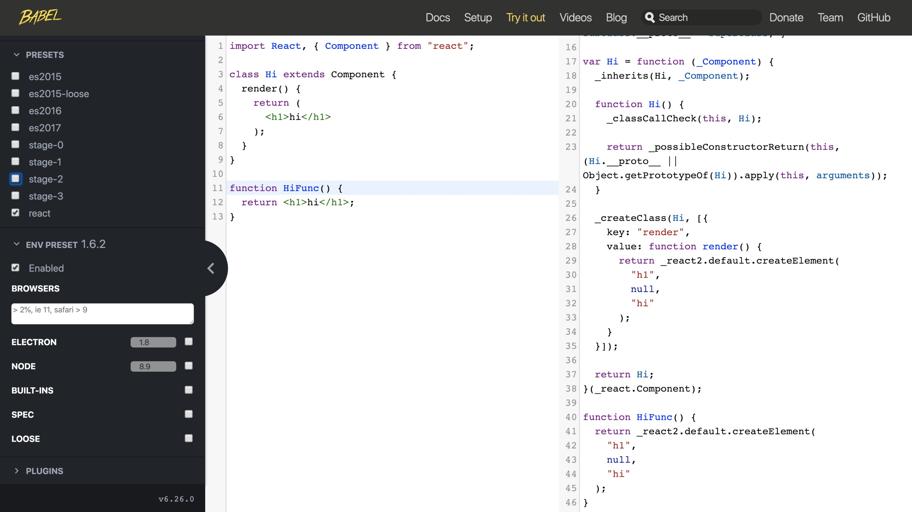



Slide 11
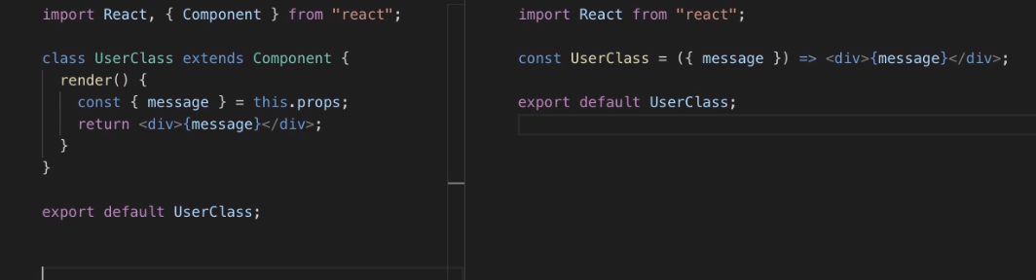

Slide 12







☺

Slide 13


☺

Slide 14
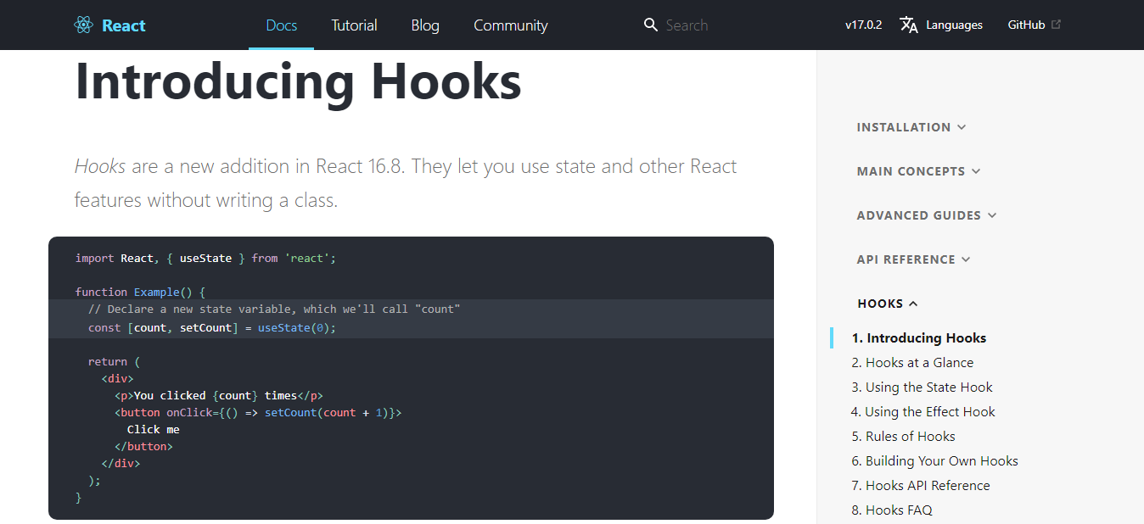

Slide 15


Slide 17










Slide 18










Slide 19




Slide 20






